Slide 1


Brington CE School
Christian Narrative

Slide 2

Thessalonians 5.11
Therefore encourage one another and build each other up, just as in fact you are doing.

Slide 3
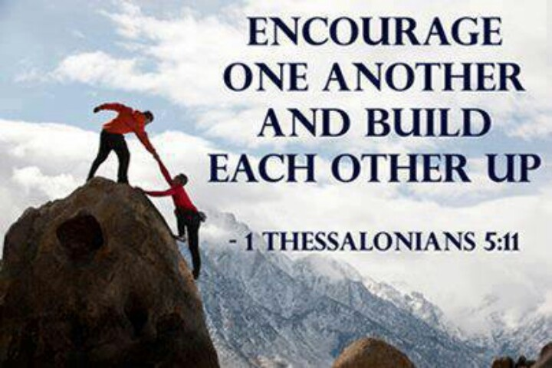
Message in the bible to carry on in hardship.
Not giving up, linking to our teaching style of going for the advancing and deep level of learning.

Slide 4

Linked to our harvest festival and giving thanks.
Giving people hope
Giving thanks to the church.

Slide 5

Progress in faith
Linked to progress in faith in ourselves and making progress in learning.

Slide 6

Encouragement and inspiration
We continually remember before our God and Father your work produced by faith, your labor prompted by love, and your endurance inspired by hope in our Lord Jesus Christ. because our gospel came to you not simply with words, but also with power, with the Holy Spirit and with deep conviction.

Slide 7

May the Lord make your love increase and overflow for each other and for everyone else, just as ours does for you.

Slide 8
Thessalonians 5.11
Therefore encourage one another and build each other up, just as in fact you are doing.

